Slide 1
The Explanation

Slide 2
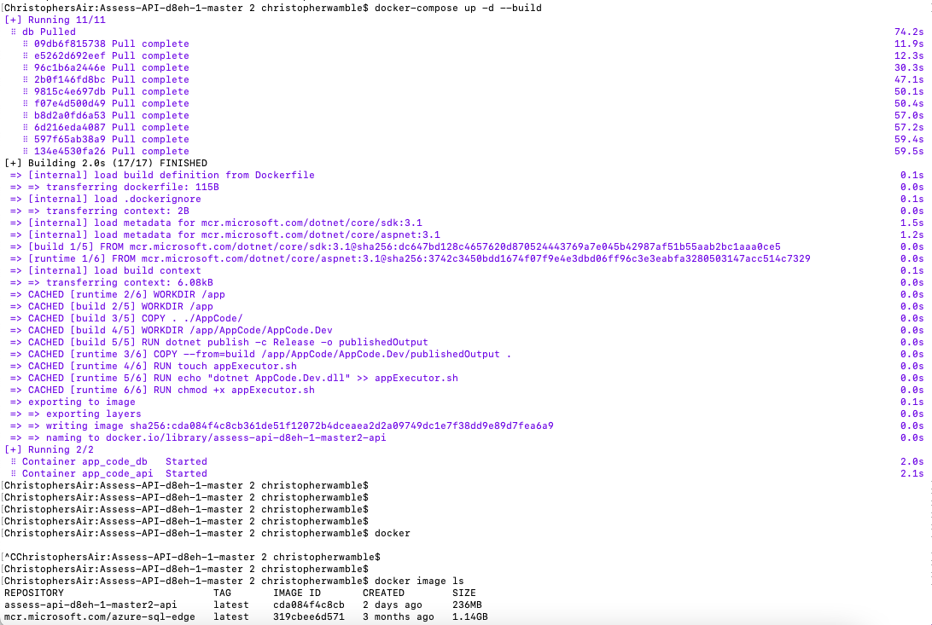
What I tried
Installing docker
Navigate to project folder and run `docker-compose up -d --build`
Confirmed build completed successfully and that image and container are up and running

Slide 3
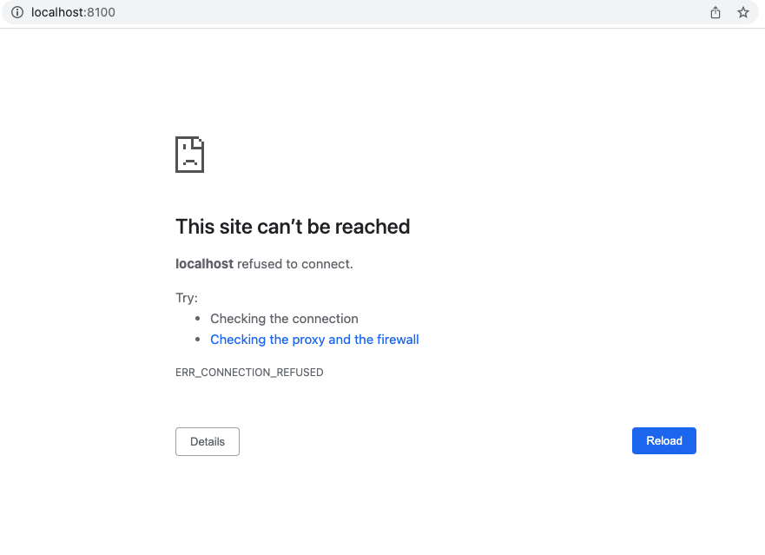
What I tried
Launch http://localhost:8100
No such page, unable to view Swagger.UI documentation

Slide 4
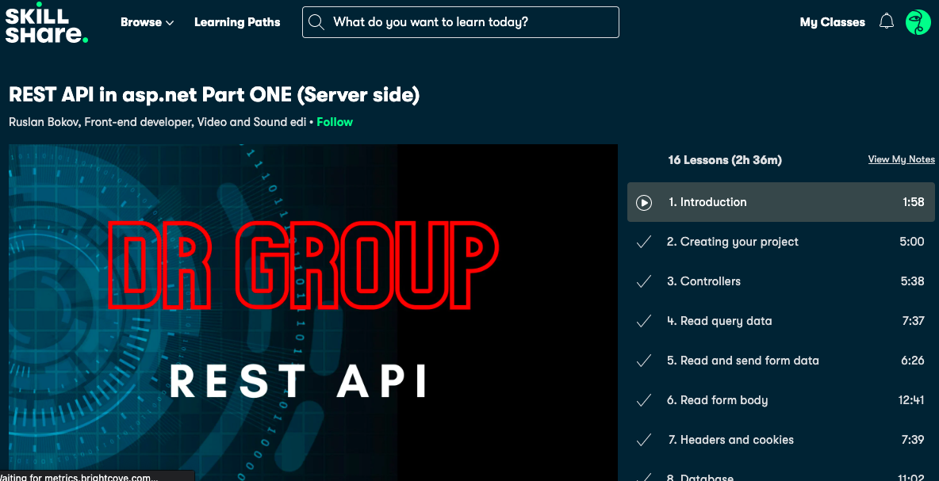
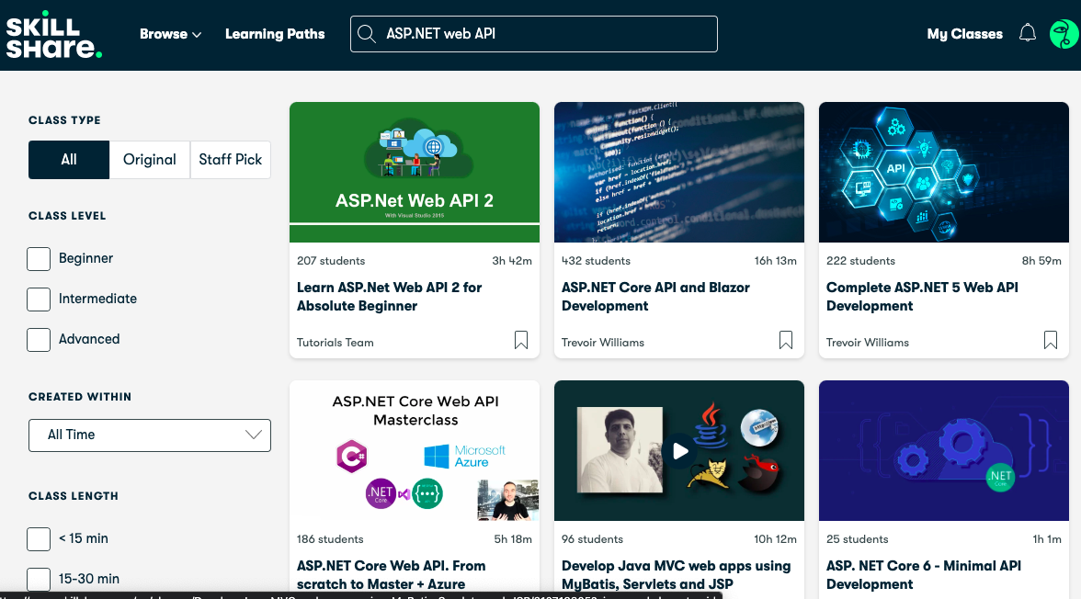
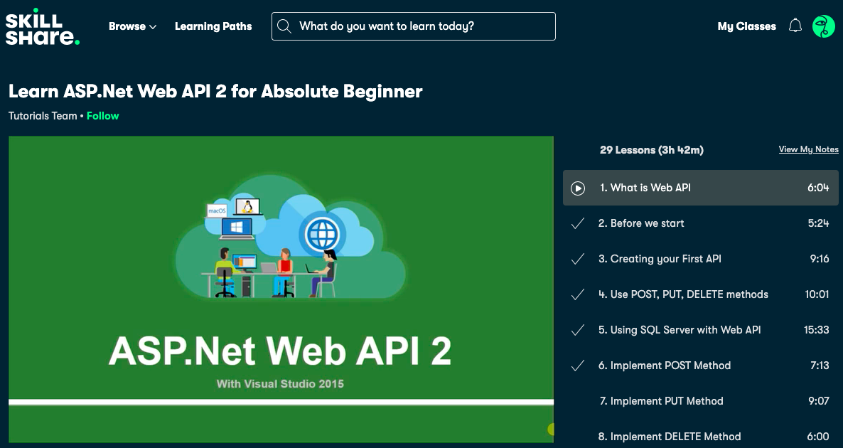
What I tried
Since I’m not experienced in coding ASP.NET or coding APIs, I reviewed ASP.NET tutorials from my personal skillshare account to get a better understanding.

Slide 5
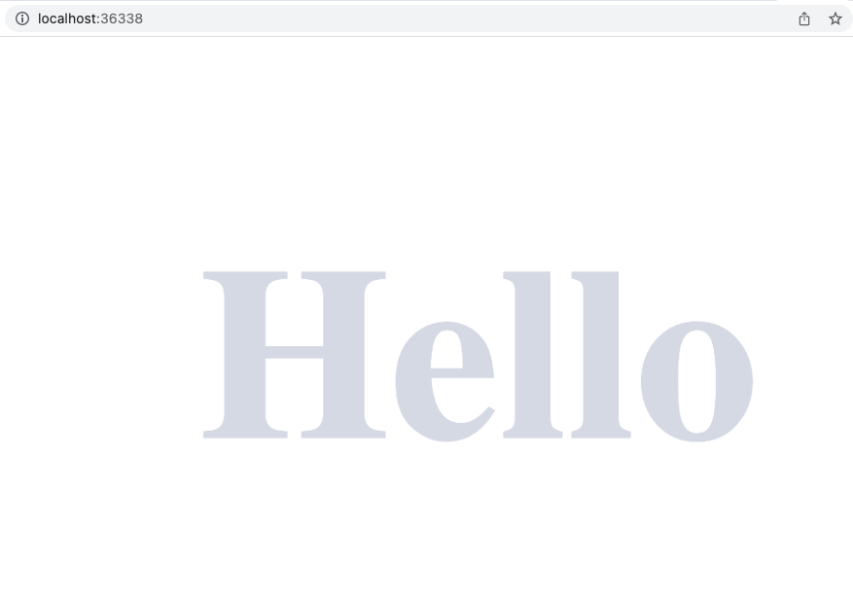
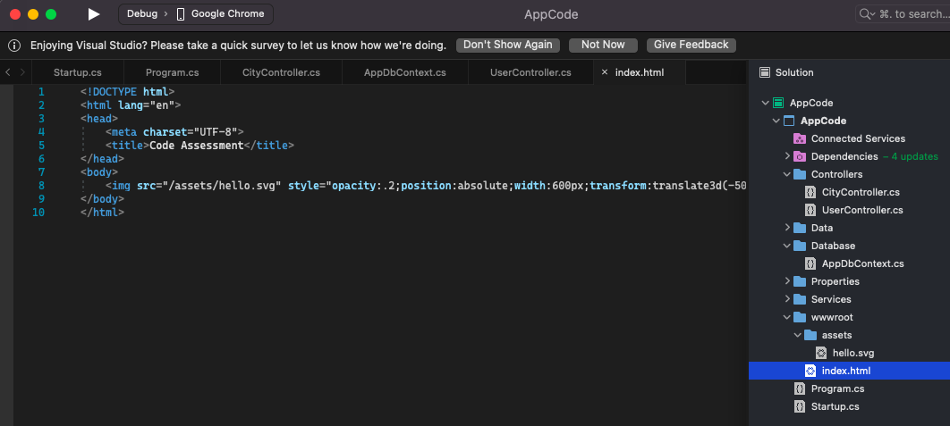
What Worked
Downloaded Visual Studios for Mac (Intel Chip), version 2022
Opened the project, compiled it, ran it
Able to get generated webpage in the project successfully

Slide 6
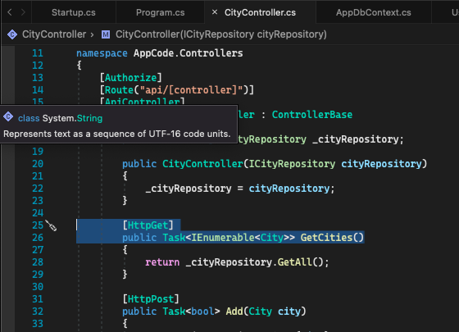
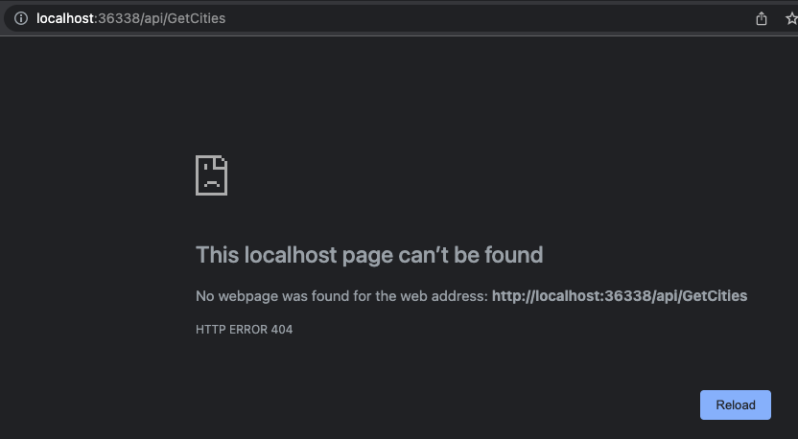
But also, what didn’t work
Attempted to append the API call for GetCities
Expected to see a list of existing cities, or a response that there are no cities.
Response was localhost page can’t be found

Slide 7
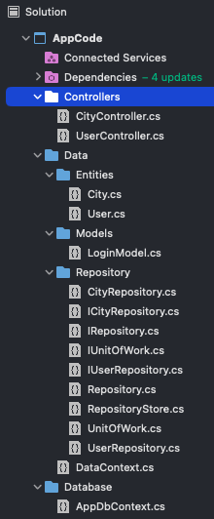
What I tried
While going through the tutorial walkthroughs on Skillshare, I attempted to compare any useful information with the code I was presented.
It appears to me I would need to write out code that is missing from some of the methods provided. This may include having to add Route headers and going down a deeper rabbit hole of understanding the relationship of the Controllers with the Data Entities, Models, and Repositories, and how they all funnel into the Database for storage, modification, and retrieval.
I feel at this point, without an experienced programmer to help guide me through the coding, it would take me more than the allotted time of 1 week to complete this project.

Slide 8
What I would do in a
Perfect World

Slide 9
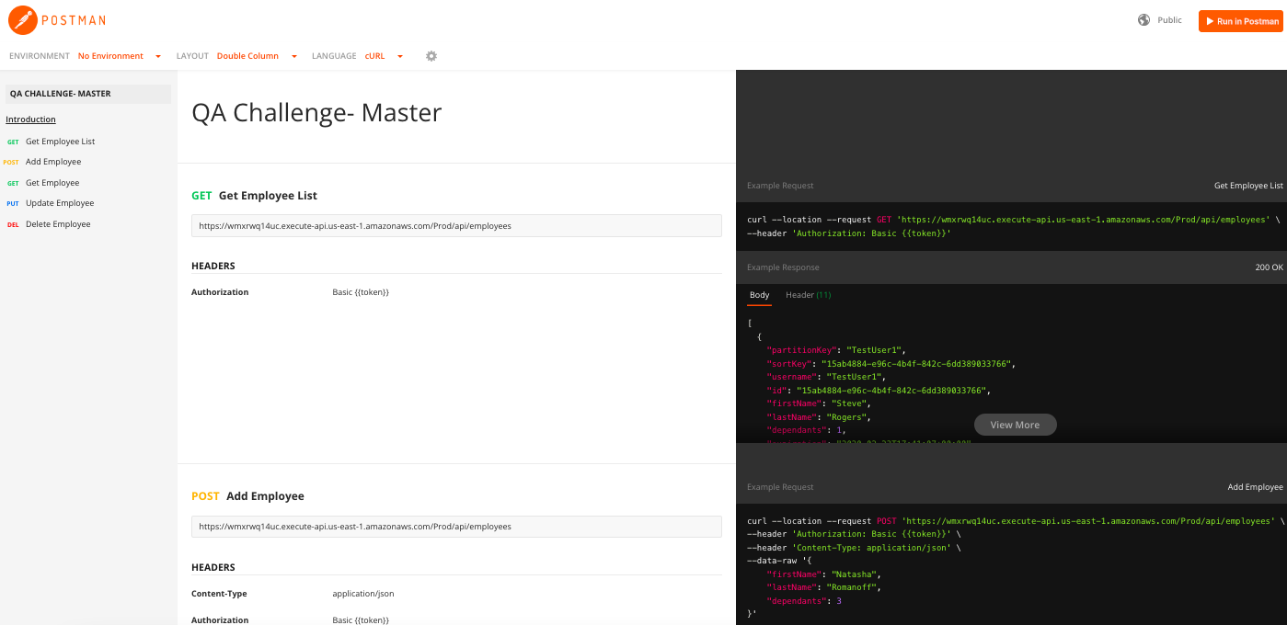
Accessible API
Easy access to API documentation
Given an auth token or an API call to extract a token

Slide 10
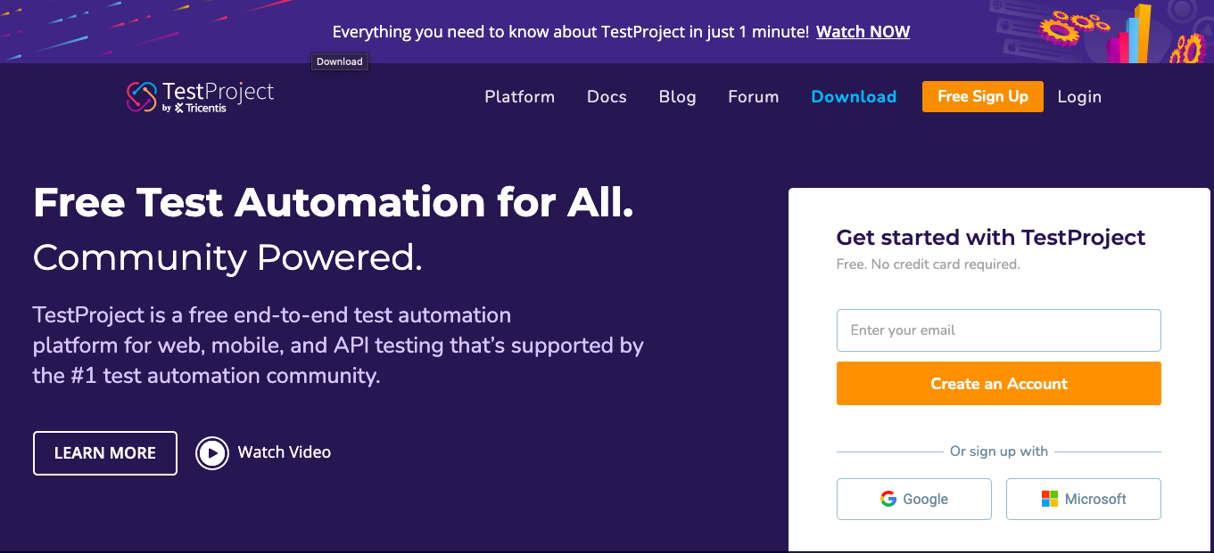
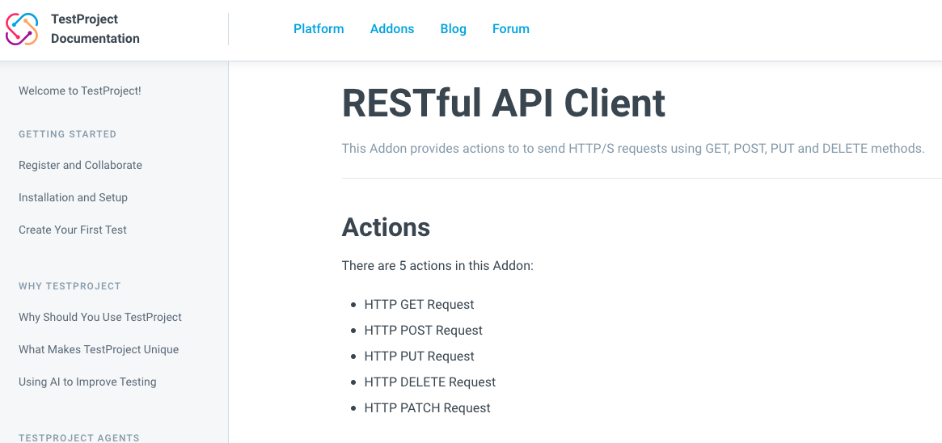
Tool I would use
TestProject.io utilizing its RESTful API Client Addon microservices
https://docs.testproject.io/testproject-addons/available-addons/restful-api-client-addon

Slide 11
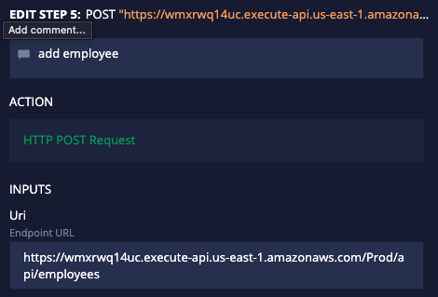
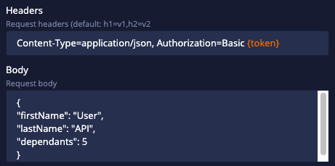

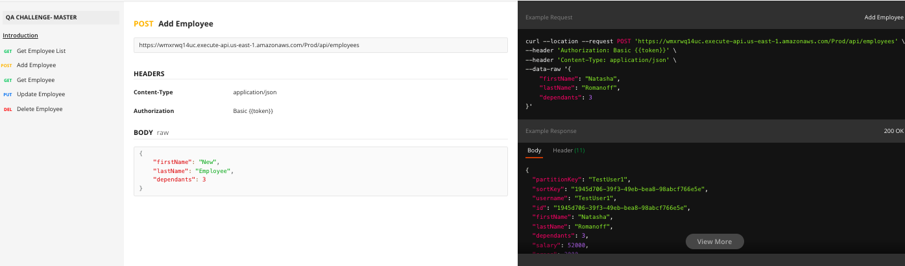
Task 1: Create User Account
API for Create User Account would have a format like the following:
POST Add Employee => POST Add User
firstName => Name (String)
lastName => Email (String)
Dependents => Password (String)
Create a step to invoke the call and confirm a 200 status
Create additional steps to test edge cases:
Errors from incorrect input (int instead of String)
Submit empty values and confirm an error code response
Character limits

Slide 12
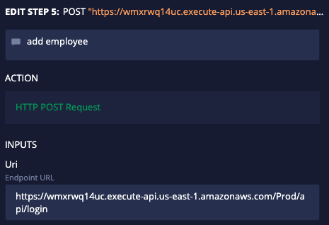
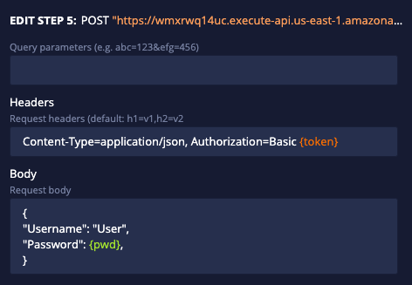
Task 1A: Login Authentication
API for Login User would have a format like the following:
POST Add Employee => POST Login User
firstName => Username (String)
lastName => Password (String)
Create a step to invoke the call and confirm a 200 status for an existing user
Create a step to invoke the call and confirm an error code for a non-existent user
Create additional steps to test edge cases:
Errors from incorrect input (int instead of String)
Submit empty values and confirm an error code response
Character limits

Slide 13
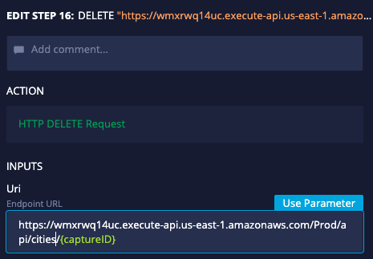
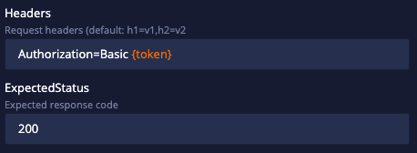
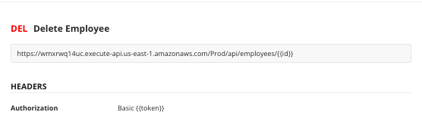
Task 2: Remove City
API for Delete City would have a format like the following:
DEL Delete Employee => DEL Delete City
Use route ‘/api/cities/{id}’
Create a step to invoke the call and confirm a 200 status that a city was created
Create additional steps to test edge cases:
No id in url
Enter characters as an id
Enter non-existent id

Slide 14
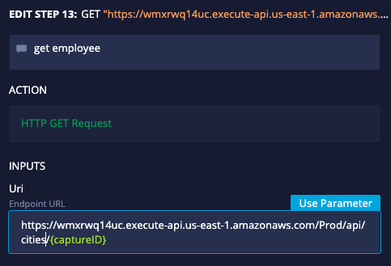
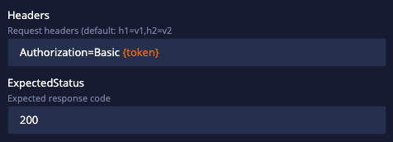
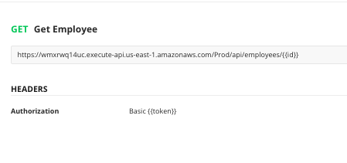
Task 2: Retrieve City
API for Retrieve City would have a format like the following:
GET Get Employee => GET Get City
Use route ‘/api/cities/{id}’
Create a step to invoke the call and confirm a 200 status that a city was created
Create additional steps to test edge cases:
No id in url
Enter characters as an id
Enter non-existent id

